Slide 1
Seng 275 software testing dr. navneet kaur popli

Slide 2
Automation testing

Slide 3

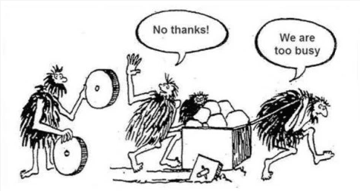
Manual vs automated testing

Slide 4
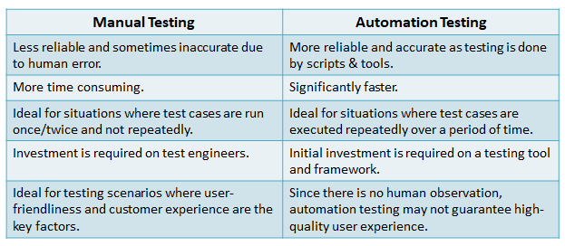

Slide 5
Test Engineer, Google, In-office: Sunnyvale, CA, USA; Mountain View, CA, USA (26/06/2022)
About the job: At Google, our philosophy is build it, break it and then rebuild it better. That thinking is at the core of how we approach testing at Google. Unlike roles with similar names at the other companies, Test Engineers at Google aren't manual testers -- you write scripts to automate testing and create tools so developers can test their own code. As a Test Engineer, you navigate Google's massive codebase, identify weak spots and constantly design better and creative ways to break software and identify potential problems. You'll have a huge impact on the quality of Google's growing suite of products and services.

Slide 6
Responsibilities
Develop test strategies.
Automate tests using test frameworks.
Write moderately complex code/scripts to test systems.
Responsible for monitoring product development and usage at all levels with a perspective towards improving product quality.
Create test harnesses and infrastructure as necessary.

Slide 7
Minimum qualifications:
Bachelor's degree in Computer Science or equivalent practical experience.
3 years of software development experience or 1 year with an advanced degree.
3 years of experience developing test automation in C++, Java or Python.
Experience with one of the following: Automation Frameworks/Testing, Integration Testing, Continuous Integration, or Test Design.

Slide 8
An automated testing tool
An automated testing tool can
playback pre-recorded and predefined actions,
compare the results to the expected behavior and
report the success or failure of these manual tests to a test engineer.
Once automated tests are created, they can easily be repeated, and they can be extended to perform tasks impossible with manual testing.

Slide 9
Escaped Defects Found metrics
An escaped defects is a defect that was not found by, or one that escaped from, the quality assurance team.
Typically, those issues are found by end users after released version has made available to them.
The metrics Escaped Defects Found counts number of new escaped defects found over period (day, week, month).

Slide 10
Advantages of automation testing
No human intervention required
Saves cost.
Fast, accurate, efficient, reliable, consistent
Humans have to sleep-machines don’t.
It is difficult to test for multilingual sites manually
Scales well.
Does repetitive tasks well. Manual Testing can become boring and hence error-prone.
Early defect detection.
Less ‘Escape Defect Found’
Easy to prepare environment for DevOps for CICD pipelines.
Wider test coverage of application features
Re-usable test scripts
Early time to market

Slide 11
Advantages of automation testing
Automated testing can do what work very effectively and is quickly replacing 50-100 testers.
Testing has matured. You are no longer only focussing on functionality but giving most of your attention to user requirements.
Successful testing also involves evaluating user requirements.
Test Frequently and thoroughly: Automation testing runs on every build including doing regression testing. Number of builds are a lot so testing every build on time is easier with automation.
Backward compatibility can be tested as well in addition to all different types of tests.

Slide 12
Advantages of automation testing
Also using automation we are writing a program and it stays with the organization. This is opposed to a tester who leaves the organization and takes his skill and experience with them.
Normally you would start the automation test at 12:00 pm at night and it will give you the result at 8:00 am in the morning.
You add a new feature, within 2 hours you would get the test results for that feature. So there is early problem detection. More lag time makes the fix more costly.
Also say it has to install some drivers for testing environment which is a very tedious manual activity. It takes 10 people 20 man hours. In automation, those man hours are saved.

Slide 13
Using VMs for automation testing
Using VMs you can do different tests parallelly.
You can scale well.
You can install different platforms in different VMs for different types of testing.

Slide 14



Manual testing is still important
Where you have to sit with the customer and make sure all his requirements are properly captured.
You have to prepare scenarios for the customers, validate flows etc.
The user perspective and look and feel is important.

Slide 15
Selenium web testing

Slide 16
Selenium
Selenium is a free (open-source) automated testing framework used to validate web applications across different browsers and platforms.
You can use multiple programming languages like Java, C#, Python, JavaScript, Ruby, PHP etc. to create Selenium Test Scripts.
It supports a number of browsers (Google Chrome 12+, Internet Explorer 7,8,9,10, Safari 5.1+, Opera 11.5, Firefox 3+) and operating systems (Windows, Mac, Linux/Unix).
It is not mandatory to write Selenium code in the same language as the application.

Slide 17
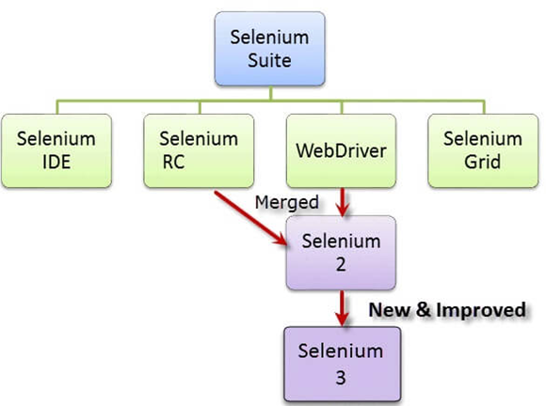

Slide 18
Selenium Suite
Selenium IDE:
Selenium IDE (Integrated Development Environment) is primarily a record/run tool.
It is an Add-on or an extension available for both Firefox and Chrome that generates tests quickly through its functionality of record and playback.
You don’t need to learn any test scripting language for authoring any functional tests.
Selenium Webdriver is an open-source collection of APIs which is used for testing web applications. Selenium WebDriver is an enhanced version of Selenium RC.

Slide 19
Selenium Suite
Selenium Remote Control: This tool allows you to develop responsive design tests in any scripting language of your choice. Its architecture is complex, and it has its limitations.
Selenium Grid is a part of the Selenium Suite that specializes in running multiple tests across different browsers, operating systems, and machines in parallel.
It is achieved by routing the commands of remote browser instances where a server acts as a hub.
A user needs to configure the remote server in order to execute the tests.

Slide 20
Locators in Selenium
Locators are the way to identify an HTML element on a web page.
Identification of correct GUI elements is a prerequisite to creating an automation script.
But accurate identification of GUI elements is more difficult than it sounds. Sometimes, you end up working with incorrect GUI elements or no elements at all!
Hence, Selenium provides a number of Locators to precisely locate a GUI element.
Locator can be created by ID, XPATH Code, or Cascading Style Sheets (CSS)

Slide 21
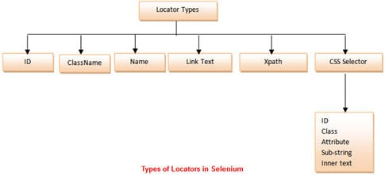
Locators
Ref: https://www.softwaretestinghelp.com/wp-content/qa/uploads/2014/10/Types-of-Locators-in-Selenium-1.jpg

Slide 22
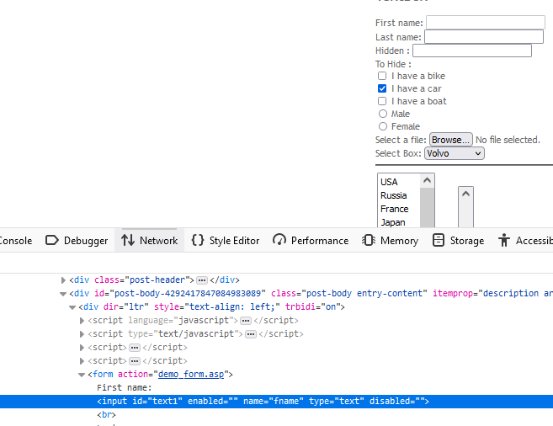
Locators in a web page. Right click on web page element->Inspect
Two languages: HTML and CSS
HTML-Tag name, attribute, value

Slide 23
What is a CSS Selector?
Essentially, the Cascading Style Sheets, CSS Selector combines an element selector and a selector value that can identify particular elements on a web page.
Like XPath, CSS selector can be used to locate web elements without ID, class, or Name.
XPATH is a query language for XML-like documents, such as web pages.
It can be awkward to write, brittle, and even more awkward to reverse engineer.
As a result, CSS has gained favor as the way to identify objects in WebDriver.
CSS:
Tag and ID
Tag and class
Tag and attribute
Tag, class, and attribute
Inner text

